Slide 1


VPC
PEERING

Slide 2




Key Points:
01
-Connects two VPCs.
-Uses existing VPC IDs (stored in variables).
-Immediately captures the new peering connection ID.
-Enables further automation in scripts.

Slide 3
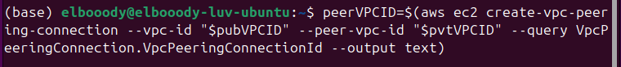
02
THE FIRST COMMAND
TO DO:

Slide 4

03
COMMAND BREAKDOWN:
PURPOSE: CREATES A VPC PEERING CONNECTION AND STORES THE ID.
MAIN COMMAND: AWS EC2 CREATE-VPC-PEERING-CONNECTION.
PARAMETERS:
--VPC-ID "$PUBVPCID": REQUESTER VPC.
--PEER-VPC-ID "$PVTVPCID": ACCEPTER VPC.
OUTPUT PROCESSING:
--QUERY: EXTRACTS THE CONNECTION ID.
--OUTPUT TEXT: FORMATS OUTPUT AS PLAIN TEXT.
VARIABLE ASSIGNMENT: STORES RESULT IN PEERVPCID.

Slide 5

04
the seconed command
to do:

Slide 6
05
Command Breakdown:
Purpose: Accepts a pending VPC peering connection.
Main Command: aws ec2 accept-vpc-peering-connection.
Parameter:
--vpc-peering-connection-id "$peerVPCID": ID of the peering connection to accept.

Slide 7
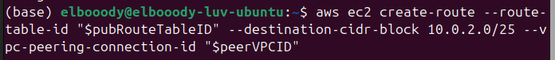
06

Slide 8
07
Command Breakdown:
Purpose: Adds a route to the public VPC route table for peering connection traffic.
Main Command: aws ec2 create-route.
Parameters:
--route-table-id "$pubRouteTableID": ID of the route table to modify.
--destination-cidr-block 10.0.2.0/25: IP range for the peered VPC.
--vpc-peering-connection-id "$peerVPCID": ID of the VPC peering connection.

Slide 9
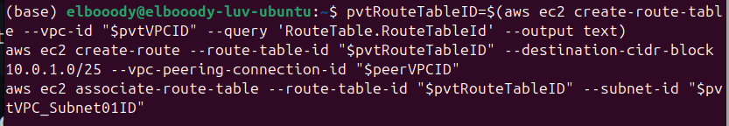
08

Slide 10
09
Command Sequence Breakdown:
Create Route Table:
-Creates a new route table for the private VPC.
-Stores the new route table ID in $pvtRouteTableID.
Create Route:
-Adds a route to the new private VPC route table.
-Points to the public VPC's CIDR block via the peering connection.
-Associate Route Table:
-Links the new route table to a subnet in the private VPC.

Slide 11
10

Slide 12
11
Command Breakdown:
Purpose: Adds an inbound rule to allow SSH access from the public VPC.
Main Command: aws ec2 authorize-security-group-ingress.
Parameters:
--group-id "$pvtSecGrpID": ID of the private VPC's security group.
--protocol tcp: Specifies the TCP protocol.
--port 22: Allows access on port 22 (SSH).
--cidr 10.0.1.0/24: Source IP range (public VPC's CIDR block).

Slide 13
12
Qusetions?

Slide 14

13
BY:
Abdulrahman Hamada Yousef
THANKS!

